Slide 1

Teaching and testing L2 Interactional Competence Online
Borbala Samu (Università per Stranieri di Perugia)

Slide 2
Presentation outline
L2 Interactional Competence
Online Interaction
Empirical evidence: CA research on L2 interactional competence
A survey of Italian Language Teachers
Final considerations

Slide 3
L2 Interactional competence (IC)
Hymes (1972)
CC were considered statically, as cognitive properties/abilities of the individual
Kramsch (1986)
contrast between the concept of proficiency and the concept of interaction
Hall (1993, 1995, 1999) and Young (2003)
dynamic and socioculturally grounded interpretation of IC

Slide 4
L2 Interactional competence (IC)
IC is “the ability of speakers to co-construct a turn (or a series of turns) in the here-and-now of the unfolding interaction that balance speaker intent with recipient desing.»
(Cambell-Larsen 2014: 268)

Slide 5
L2 Interactional competence (IC)
“Research in the field of applied linguistics taking in the knowledge from conversation analysis (…) has emphasized the interactional aspect of fluency in dialogue, which is described by McCarthy (2010) as “confluence” (p. 7). This interactional aspect posits that participants in a dialogue share the responsibility of maintaining fluency across turns and therefore entails how fluency is displayed in collaboration.”
(De Jong 2018)

Slide 6
L2 Interactional competence (IC)
L2 users are to be considered for their emergent, co-constructed ability to interact with others by making sense of each other’s actions.
L2 users are to be assessed for their ability to understand the actions accomplished by prior turns-at-talk and to respond to those actions with relevant and fitting turns-at-talk.
(Salaberry, Kunitz 2019)

Slide 7
L2 Interactional competence (IC)
“In interactive activities the language user acts alternately as speaker and listener with one or more interlocutors so as to construct conjointly, through the negotiation of meaning following the co-operative principle, conversational discourse” (Council of Europe 2001: 73).
Class of strategies exclusive to interaction

Slide 8
L2 Interactional competence (IC)
IC competence
“the underlying competence of learners on which they draw to participate in their interactions”
“the diverse language-specific linguistic forms and other resources that learners develop from their participation in diverse social contexts over time”
(Hall 2018: 25)

Slide 9
L2 Interactional competence (IC)
“In teaching and assessing L2 IC, this argument is particularly important, as test constructors and raters face the task of deciding whether a particular assessment format captures a kind of general human knowledge of social organization and interaction along with L2-specific practices that learners have acquired”
(Sandlund, Sundqvist 2019: 359 )

Slide 10
Online Interaction
Online interaction is a dimension that has acquired considerable importance in recent years
Online interaction has some peculiar characteristics:
possibility to find and share materials and resources;
cases of misunderstanding are more frequent;
interactants have specific needs, such as highlighting the meaning of the message using redundancy or reformulation;
need to receive immediate feedback.
New descriptors (Companion Volume 2018)

Slide 11
Online Interaction
Interaction activities
Interaction Strategies
Spoken Interaction
Written Interaction
Online Interaction
  Online conversation and discussion
  Goal-oriented online transactions and collaboration
(illustrative scales)
Taking the floor (Turntaking)
Cooperating
Asking for clarification
(Council of Europe 2018: 83-104)

Slide 12

Online Interaction
E-learning
Allows for various forms of synchronous (chat) and asynchronous (forum, mail, instant messages) communication;
- "one to one" communication (for ex. teacher sends feedback to a student), "one to many" (for ex. teacher sends a notice to students), "many to many" (for ex. collaborative discussion in a forum).
Favors collaborative learning methods and the creation of learning communities.

Slide 13
Online Interaction
Synchronous oral interaction
Real-time interaction between students and teachers
Suitable for implementing
- communicative approaches;
- methods based on the oral dimension of the language;
- techniques such as role-play and discussions.
Tools:
- videoconference and chat;
- shared files;
- breakout rooms for group work.

Slide 14
CA research on L2 interactional competence
Analysis of transcripts of video recorded online language lessons
  Synchronous lessons in videoconference through Microsoft Teams held at the University for Foreigners of Perugia between March 2020 and June 2021
  Main research questions: Why do L2 Italian teachers find the interaction worsened compared to face-to-face lessons? Which online teaching methods and techniques favour the development of confluence in L2?

Slide 15
CA research on L2 interactional competence
As Walsch observes (2016: 72), most of what happens in the L2 classroom (and in particular in the assessment) is more about individual performance than collective competence: there is a tendency to emphasize the learner's ability to produce correct sentences, rather than negotiating meanings, that is, fluency and accuracy are placed before confluence.

Slide 16
CA research on L2 interactional competence
Critical aspects
  Unidirectionality of communication
  Classroom dominated by teacher talk
  Organization of the interaction predominantly follows the “star model” (Castellani 2000) and the method adopted is mainly frontal teaching.
learner
learner
learner
teacher
learner
learner

Slide 17
A survey of Italian Language Teachers
Why interaction is problematic in online courses?
A survey to teachers of Italian language and culture of the University for Foreigners of Perugia (March 2021)
asynchronous lessons on the Moodle platform
synchronous videoconferencing through Microsoft Teams

Slide 18
A survey of Italian Language Teachers
What kind of activities do you create on the Moodle platform that allow collaboration and interaction between students?

Slide 19
A survey of Italian Language Teachers
What kind of interaction do your Moodle activities allow?

Slide 20
A survey of Italian Language Teachers
What are the main challenges of interaction on Moodle?
1.
The lack of willingness to cooperate
Lack of appreciation of activities such as the forum by specific types of students
2.
Perhaps my limited competence?
My technological incompetence, but also of the students at times
It takes too long to organize the work

Slide 21
A survey of Italian Language Teachers
What kind of activities do you propose on Teams that allow collaboration and interaction between students?

Slide 22
A survey of Italian Language Teachers
What are the main difficulties in managing interaction on Teams?
«Reluctance of the students»
«they are not able to move between virtual classrooms»
«Lack of willingness to collaborate»
«There are no big problems, apart from the technical issues, such as Internet connection»

Slide 23
A survey of Italian Language Teachers
What solutions did you adopt to face these challenges?
Enhance student engagement
Request to turn on the webcam and "show themselves"
Solutions related to technology
Use what you are sure of (avoid innovative methods and techniques)
Contact a technician or colleagues
Solutions related to methodology
Specific methods, such as flipped classroom

Slide 24
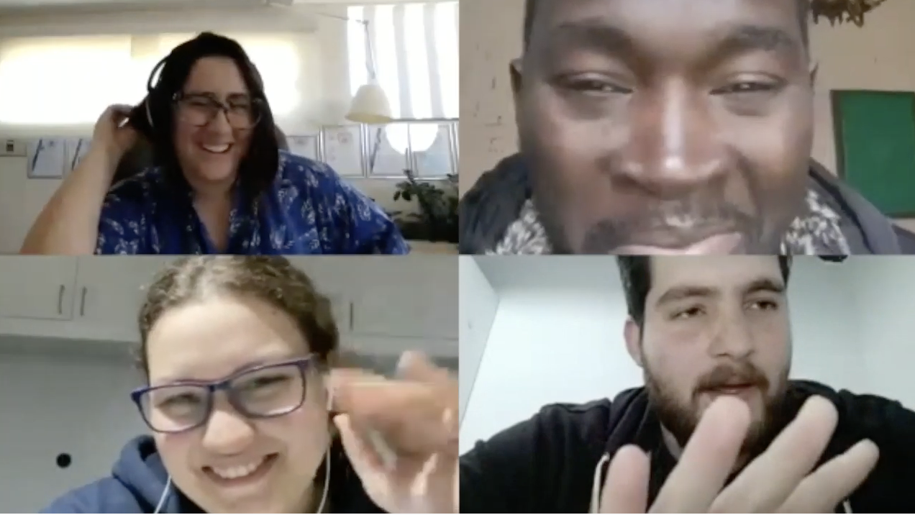
CA research on L2 interactional competence
Good practices
  Group work in breakout rooms
  Task-based teaching
  Interactive apps (for ex. Kahoot!)

Slide 25
CA research on L2 interactional competence
(8) T: (…) dovete parlare tra di voi eh ragazzi, okay? Io io sto zitta
you have to talk to each other huh guys, I am silent
(9) L3: Quindi chi c'è adesso? (1.5) Gioia ci, sei?
So, who is there now? Gioia, are you there?
(10) L2: (Dimmi)
Tell me
(11) L3: Non ti sento molto bene
I can’t hear you very well
(12) L2: Che ne pensate di questo tema?
What do you think about this topic?
(13) L3: Di cosa?
About what?
(14) L2: Puoi sentirmi?
Can you hear me?
(15) L3: Adesso sì, prima no
Now yes, before no
(16) L2: Aha Cosa ne pensate?
Aha What do you think?
(17) L3: Mh aha
Mh aha
(18) L2:(per) un bene ri irrinunciabile, e Sud e isole è più (approvare)?
(as) an essential good, the South and the Islands is more (to approve)
(19) L3: Cosa?
What?
(…)

Slide 26
CA research on L2 interactional competence
(34) L2: Mh e della giustificazione di un sistema basato su assistenzialismo e mh il Nord il Nord mh ci sono in numero più alto
Mh and the justification of a system based on welfare and mh the North the North mh there are higher numbers
(35) L3: Sì
Yes
(36) L2: In cui, sì mh, mh la maggior parte mh pensano che un bene irrinunciabile e mh, favorire favorirle favorire a Unità nazionale
In which, yes mh, mh most mh think that an essential good and mh, is to favor favor national unity
(37) L3: Mh Mh
Mh mh
(38) L2: Che che ne pensate?
What do you think?
(39) L3: Di questo niente di più aha quindi, sì sembra che per la maggior parte, l'Unità nazionale significhi un bene irrinunciabile, e (1.5) mh poi mh magari c'è una differenza tra, l'opinione del Nord e del Sud per quanto riguarda la realtà storica, una realtà storica, perchè, no tra Nord e Sud ma tra Nord e Centro, quindi, per il Nord mh [
About this nothing else, then yes it seems that for the most, the national unity means an essential good, and (1.5) mh then mh maybe there is a difference between the opinion of the North and the South as far as it concerns historical reality, because, not between North and South but between North and Center, therefore, for the North mh
(40) L2: [ Stato medio [
Average state
(41) L3: [ (Sembra importante)
It seems important
(42) L2: Stato medio è cosa? No non ho capito stato medio
What is average state? No I did not understand average state
(43) L3: Non ne ho parlato ma è ventidue
I did not talk about it, but it is twenty-two
(44) L2: No stato medio qua cosa significa?
No, what does it mean, average state?
(45) L3: Ah okay (average), mh quando prendi tutta le dati cioè Nord Centro e Sud aggiungi [
Ah, ok (average [learner translates the word in English]) when you take all the data, that is you add North Center and South
(46) L2: [ Ah
Ah
(47) L3: Poi lo condividi con il numero dei com componenti
Then you divide it with the number of com components
(48) L2: Sì
Yes
(49) L3: E quindi ricevi un medio, hai capito?
And so you get a ‘medio’ [media – average; medio – middle], do you understand?
(50) L2: Sì sì sì e quindi (1.5) mh
Yes yes, and then
(51) L3: Forse dovremo parlare del del grafico a torta?
Maybe we should talk about the pie chart?

Slide 27
CA research on L2 interactional competence
The use of paired and group tasks in classroom and assessment contexts have the potential to tap into a wide range of a learner’s interactional ability, including specific strategies learners display in online communication.
The use of learning activities that are meaningful and engaging for the learner and that encourage interaction rather than individual production

Slide 28
Final considerations
Even though the construct of IC has been discussed in numerous publications there have been only a few attempts (for ex. Moorhouse et al. 2021) at examining learners’ (and teachers’) IC competence in synchronous online language classes.
Our study has shown that teachers need specific competences to develop IC efficiently in synchronous online teaching.

Slide 29
Final considerations
Online environment management competences
Technical know-how (for ex. breakout rooms)
Online teacher interactional competences
Reduce teacher talking time
Use of methodologically appropriate teaching practices (for ex. tasks)
Establish modes and rules for interacting
Development of learners' interactional competence online

Slide 30
Some references
Campbell-Larsen J. (2014), Interactional Competence in Second Language Acquisition, in “Humanities Review”, 19, pp. 265-287.
Fragai E., Fratter, I., Jafrancesco E. (2020), Insegnamento linguistico ed emergenza sanitaria: riflessioni sulla DAD, in “Italiano LinguaDue” 2, pp. 38-62.
Hall J.K. (1993), The role of oral practices in the accomplishment of our everyday lives: The sociocultural dimension of interaction with implications for the learning of another language, in “Applied Linguistics” 14(2), pp. 145-166.
Hall J.K. (1995), (Re)creating our worlds with words: A sociohistorical perspective of face-to-face interaction, in “Applied Linguistics”, 16(2), pp. 206-232.
Hall J.K. (1999), A prosaics of interaction: The development of interactional competence in another language, in Hinkel E. (ed.), Culture in second language teaching and learning, Cambridge, Cambridge University Press, pp. 137-151.
Hall J.K. (2018), From L2 interactional competence to L2 interactional repertoires: reconceptualising the objects of L2 learning, in Classroom Discourse”, 9(1), pp. 25-39.
Kramsch C. (1986), From language proficiency to interactional competence, in “The Modern Language Journal” 70(4), pp. 366-372.
Moorhouse B. L., Li Y., Walsh S. (2021), E-Classroom Interactional Competencies: Mediating and Assisting Language Learning During Synchronous Online Lessons, in “RELC Journal”, 1, 1.
Sandlund E., Sundqvist P. (2019), Doing Versus Assessing Interactional Competence, in Salaberry M.R., Kunitz S. (eds.), Teaching and Testing Interactional Competence. Bridging Theory and Practice, New York/London, Routledge, pp. 357-396.
Walsch S. (2016), Sviluppare la competenza interazionale in classe, in Andorno C., Grassi R. (a cura di), Le dinamiche dell’interazione. Prospettive di analisi e contesti applicativi, Milano, Studi AitLA, pp. 61-76.
Young R.F. (2003), Learning to talk the talk and walk the walk: Interactional competence in academic spoken English, in “North Eastern Illinois University Working Papers in Linguistics” 2, pp. 26-44.
Young R. (2011), Interactional competence in language learning, teaching, and testing, in E. Hinkel (ed.), Handbook of research in second language teaching and learning, vol. 2, New York, Routledge, pp. 426–443.

